Slide 1
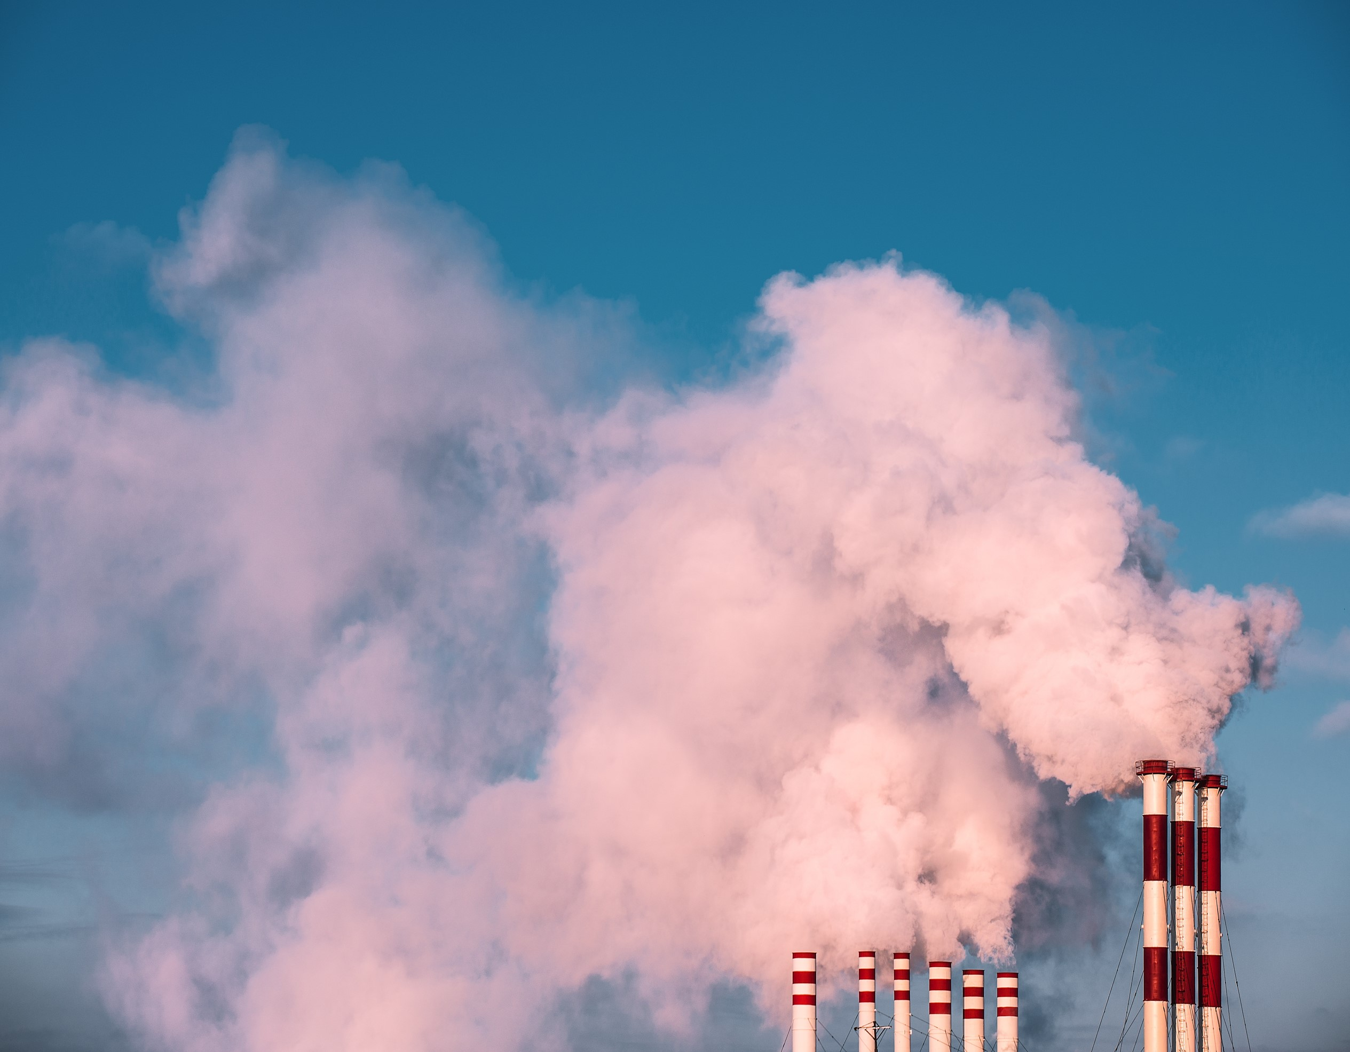

May | 2024
Shareholder resolution on scope 3 emissions at Yara International

Slide 2
Shareholder resolution at Yara’s AGM
ShareAction and members of the coalition have filed a shareholder resolution requesting the company to set comprehensive scope 3 targets:
‘Shareholders direct the company to publish science-based targets to reduce scope 3 greenhouse gas emissions over the short, medium, and long term, in line with the goal of limiting global warming to 1.5C, and to implement measures to reduce such emissions. Targets and measures should include upstream as well as downstream emissions and entail an absolute reduction in emissions. They should be disclosed before the next annual shareholder meeting in 2025.’

Slide 3




Yara’s emissions (2022)
Scope 3 upstream
Extraction and processing of fossil-based fuels & feedstocks
Scopes 1 and 2
Direct emissions from production processes (scope 1) and indirect emissions from purchased power (scope 2)
Scope 3 downstream
Emissions from application of nitrogen fertilisers to agricultural fields
+

Slide 4
Yara’s current scope 3 targets – and what’s missing
No long-term scope 3 target (or formal net-zero commitment on any scope)
No absolute near-term target covering upstream emissions—thereby omitting 15% of Yara’s emissions
Near-term downstream target (to reduce nitrogen use-phase emissions by 11.1% by 2030) is unlikely to meet ambitious 1.5C pathways for nitrogen use-phase emissions (e.g. International Fertilizer Association & SystemIQ 2022)
Intensity target covering upstream emissions from purchased ammonia will expire next year and will not result in absolute reduction

Slide 5
What Yara has said
Yara says it will produce ‘more comprehensive’ scope 3 targets by 2027—this is too late to enact ambitious emissions reductions within this decade
Yara is waiting for the publication of the SBTi chemical sector guidance—this will be published in Q3 this year
Many companies cite upstream data collection as an obstacle to setting upstream targets—but other major chemical companies (e.g. BASF) are now setting targets using verified data
Yara may convert downstream KPI from absolute to intensity-based—intensity target may not require absolute reduction in emissions
Yara may not follow guidance of ‘external standard-setters’ in setting scope 3 targets when guidance is released

Slide 6
Yara may not follow guidance of ‘external standard setters’ in target-setting
‘under the current disclosure methodologies, improved use-phase efficiency cannot be counted as a climate solution in Yara’s GHG accounting […] If external standard setters fail to acknowledge scientific facts, we will prioritize scientific evidence over established protocols’
- Yara International (2024), Yara Integrated Report 2023, p. 135

Slide 7


Fixing Nitrogen
The Impacts of Nitrogen Fertiliser
May 2024

Slide 8

Scope 3 and the Wider Context…
8
Setting and achieving downstream scope 3 GHG targets aligned with a 1.5⁰C pathway could better place Yara in a world where:
Global demand for fertiliser decreases
Nitrogen use efficiency improves in high-income countries
Market access improves in low-income countries
Consumer preferences change

Slide 9
1. Impacts & Planetary Boundaries
2. Nitrogen Use Efficiency
3. Supply & Demand
Impacts & Planetary Boundaries
What happens when we use too much fertiliser?

Slide 10


Impacts…
10
United States (2021) representing ~9% global nitrogen fertiliser application in FAOSTAT
Localised Impacts
Atmospheric N-Deposition
1.1 mn
Volatilisation
3.3 mn
Air Pollution (NO_{x}) & GHGs (N₂O, NH₃)
Damage to Soils
Acidification
Loss of soil structure
Less resilient to extremes
Other Losses
0.4 mn
19.6
19.6
Removal by Crop
14.2 mn
Wasted Fertiliser Expenditure
USD 200 bn (Globally)
Source: UNEP
N-Fertiliser Application
9.2 mn
Leaching
1.3 mn
Algal Blooms
USD 1.1 bn since 2010 (USA)
Source: EWG
Nitrogen in Seed
0.2 mn
Algal Blooms
USD 0.4 bn between 2013-18 (10 companies)
Source: Planet Tracker
Nitrogen in Manure
1.6 mn
Biological N-Fixation
7.5 mn
Source: FAOSTAT Crop Nutrient Balance Tables. Available here.

Slide 11
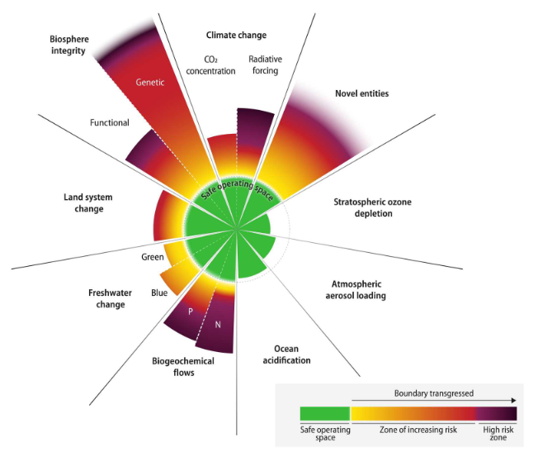
Planetary Boundaries…
11

Slide 12

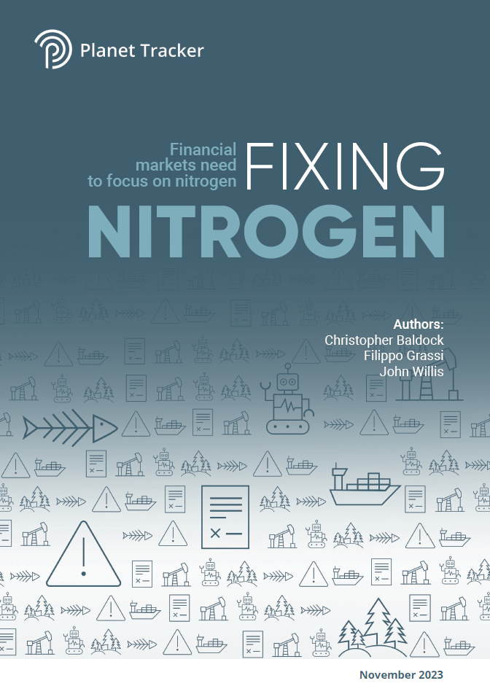








Planetary Boundaries… Nitrogen
12
NH₃ Emissions
N₂O Emissions
NO₃ in Groundwater
Exceeding
Planetary Boundaries
Economic Activity
Budget
Local
Fertiliser Use
N in Surface Water
N Concentration
Environmental & Financial Impacts
160 vs. 82 to 60
<2.5 mg l⁻¹
N Producers
N Users
Annual N Emissions
11 vs 7
Farms
1. Nitrogen Limits
2. Land & Ocean Interconnectivity… algal blooms caused up to USD 0.4 bn in forgone revenue
3. Land Use Efficiency… closing yield gaps could free up land for reforestation activities
4. Technological Bets… man-made tech versus nature-based solutions
5. Fossil Fuel Dependence of Fertilisers… the impact of natural gas on fertiliser production
6. Agriculture Dependent Trade… Brazil and Argentina’s dependence on fertiliser and agricultural exports
7. Regulating Nitrogen Pollution… nitrogen budgets, trading, and litigation

Slide 13
1. Impacts & Planetary Boundaries
2. Nitrogen Use Efficiency
3. Supply & Demand
Nitrogen Use Efficiency
How and where is fertiliser used?

Slide 14
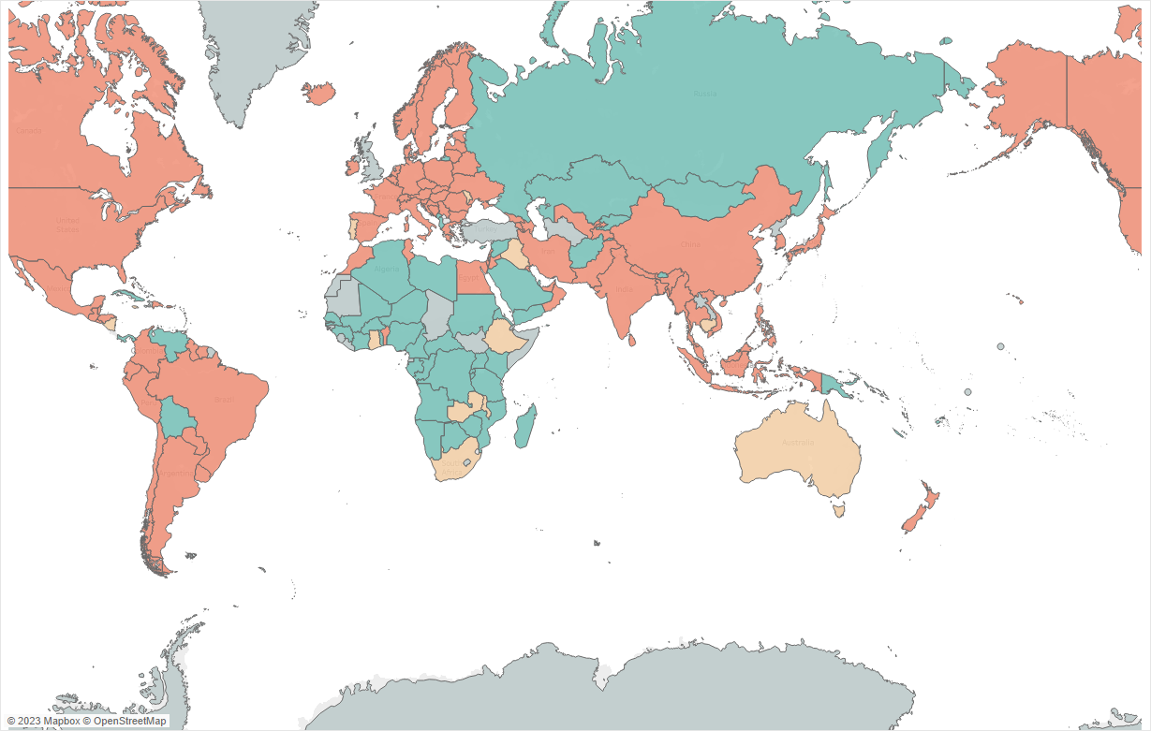
Nitrogen Use Efficiency…
14
EXCEEDING PLANETARY BOUNDARY
WITHIN DANGER ZONE
BELOW PLANETARY BOUNDARY
Source: Planet Tracker analysis

Slide 15
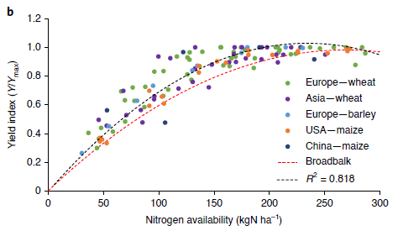
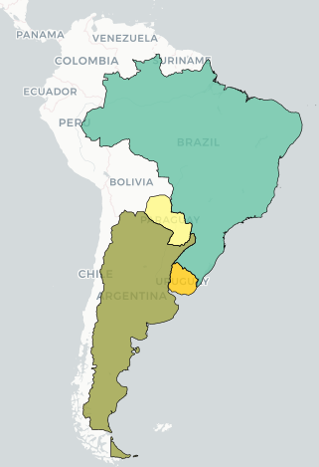
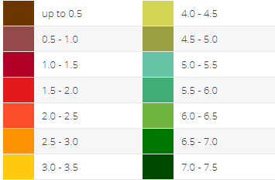
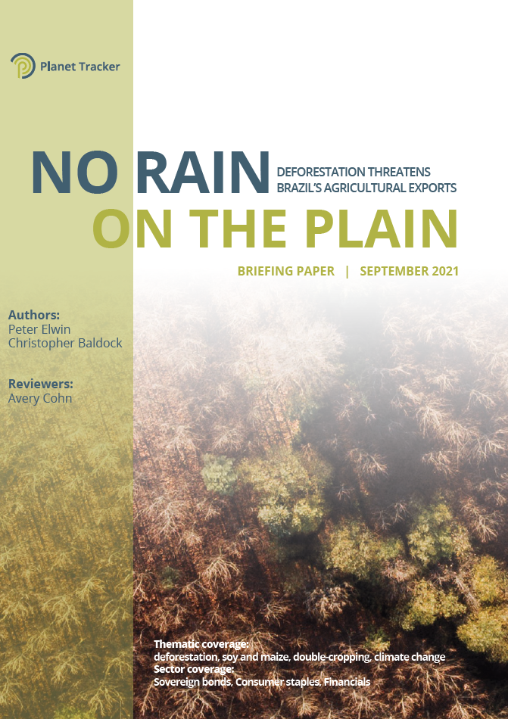
Nitrogen Use Efficiency…
15
Global Yield Gap Atlas
Brazil: 3.0 vs. 5.4 tonnes per ha (56%)
Potential Yield (t ha⁻¹)
Issues with… Fertiliser Application
Wrong time
Wrong place
Wrong quantity
Wrong type
…Farming
Lack of cover crops
Monocultures
…Climate
Changing growing seasons
Increasing extremes

Slide 16
1. Impacts & Planetary Boundaries
2. Nitrogen Use Efficiency
3. Supply & Demand
Supply & Demand
How much fertiliser will be needed in 2050 to feed the world?

Slide 17
Supply & Demand…
17
million tonnes
162
nitrogen fertiliser applied per year ^{A}
82
the upper bound of the nitrogen planetary boundary ^{A}
61
forecasted demand in 2050 due to more efficient use ^{B}
35
forecasted demand in 2050 due to more efficient use and dietary shift ^{B}
20.5
Yara’s finished fertiliser production in 2022, with a target of 22.5 in 2025 ^{C}
Are we at peak nitrogen fertiliser production, and are assets at risk of stranding?
^{A} Assessing planetary and regional nitrogen boundaries related to food security and adverse environmental impacts. Available here
^{B} Reconciling regional nitrogen boundaries with global food security. Nature Food. Available here
^{C} Yara International (2023) Yara Integrated Report 2022. Page 27. Available here. Note this will also include non-nitrogen-based fertiliser.

Slide 18






